Slide 1

Pairs Trading Strategy
QTs: Shoubhit Ravi, Aditya Nambiar
QRs: Ishan Kinikar, Kaosi Nwosu
Notes:
Slide allocations: Adi: 2-4, 6-9, 17
Shoubhit: 5, 12, 17
Kaosi: 10,11,13,14, 15
Ishan: 19-24
Shoubhit Notes: - explain the drawbacks of our trailing stop loss (based solely on spread, doesn't account for individual assets)
Explain the correlation vs cointegration
Look into combining slides 12,13

Slide 2
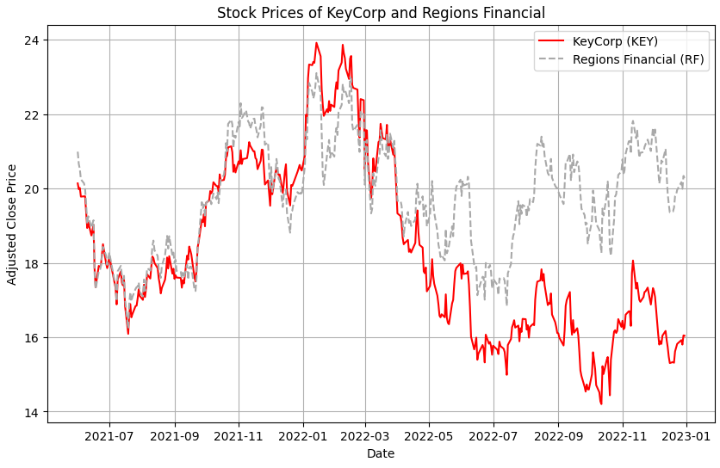
Pairs Trading at a High Level
Find two assets with prices that move together
When their spread is larger than usual:
Long: Undervalued
Short: Overvalued
Exit positions when spread reverts to mean and profit from the change

Slide 3
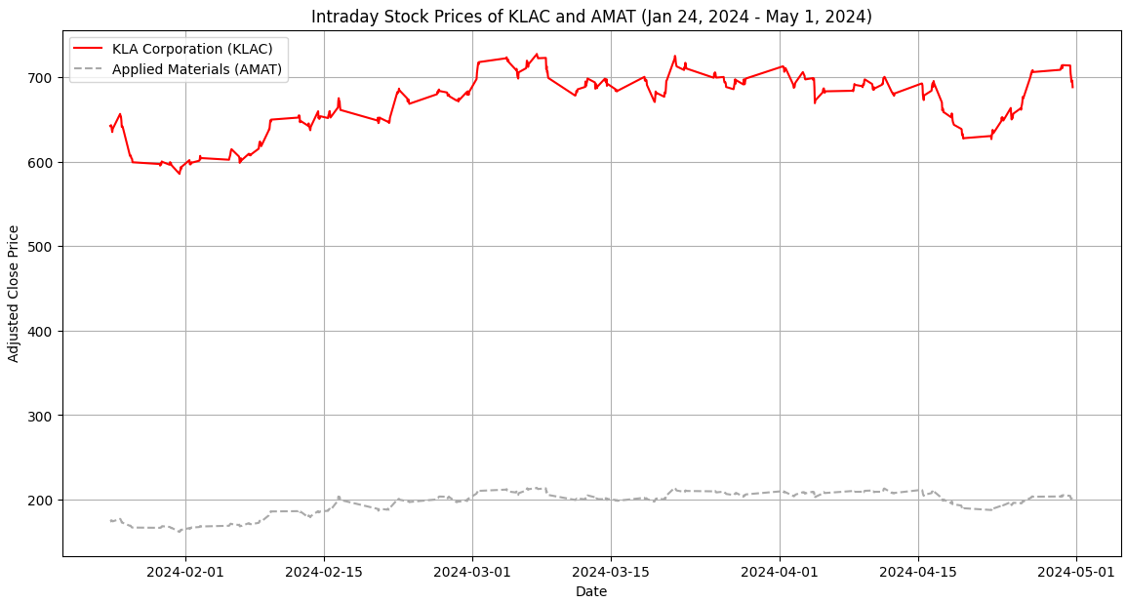
Pairs Trading at a High Level

Slide 4
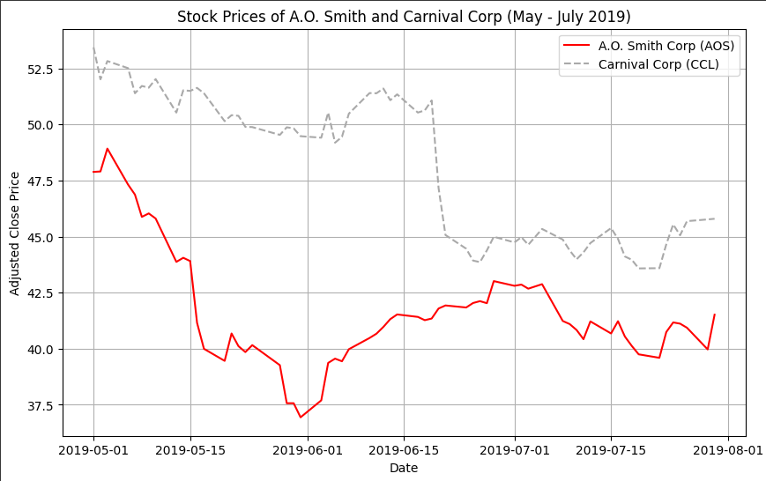
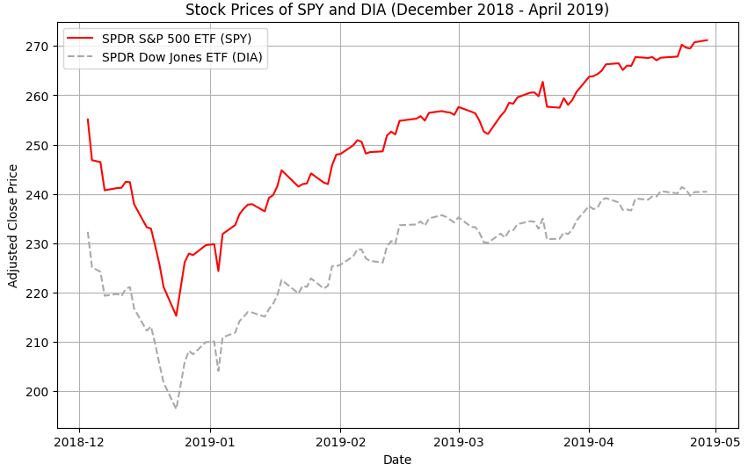
Pairs Trading is a Market Neutral Strategy
Pairs Trading on a Downward Trend
Pairs Trading on an Upward Trend

Slide 5
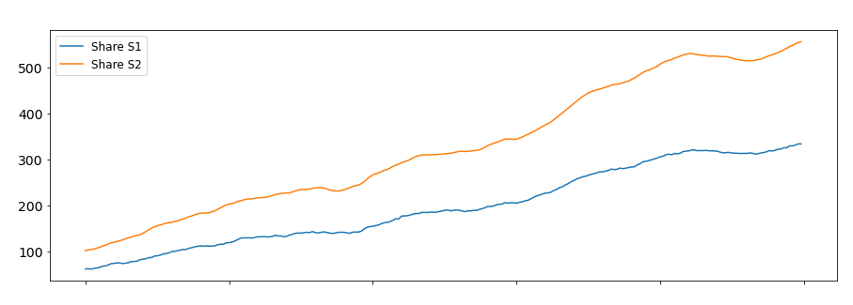
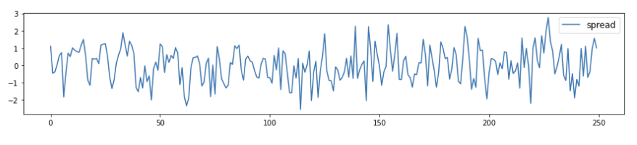
Correlation VS Cointegration
CORRELATION
Describes a short-term relationship between the returns
COINTEGRATION
Describes a long-term mean reverting relationship between the prices
Returns of two correlated assets ​
Spread (difference in prices) of these assets
Notes:
Let's introduce some key terminology before we move on to the rest of our strategy:
Correlation: measure the correlation coefficient r^2, -1 < r^2 < 1
Cointegration: perform Engle-Granger/ADF test and hypothesis testing to determine how confident we are that the pair is cointegrated

Slide 6
Quantitative and Qualitative Pairs Relationships
Effective pairs trading strategies integrate both quantitative and qualitative analyses.
Quantitative Relationships
Utilize two important statistical properties to identify relevant numerical patterns between two assets: Correlation and Cointegration
Stock prices must historically move in the same direction and have a spread that historically remains constant
Qualitative factors are necessary in providing context to the numbers
Qualitative Relationships
Non-numerical factors that influence asset behavior: Industry trends, company fundamentals, market sentiment, etc.
Two highly correlated companies are not guaranteed to maintain that relationship over the long-term due to unexpected events and catalysts
Effectively utilizing most recent company news is necessary

Slide 7
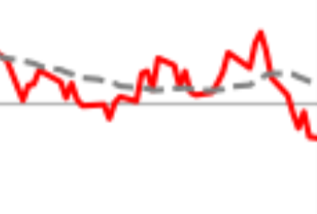
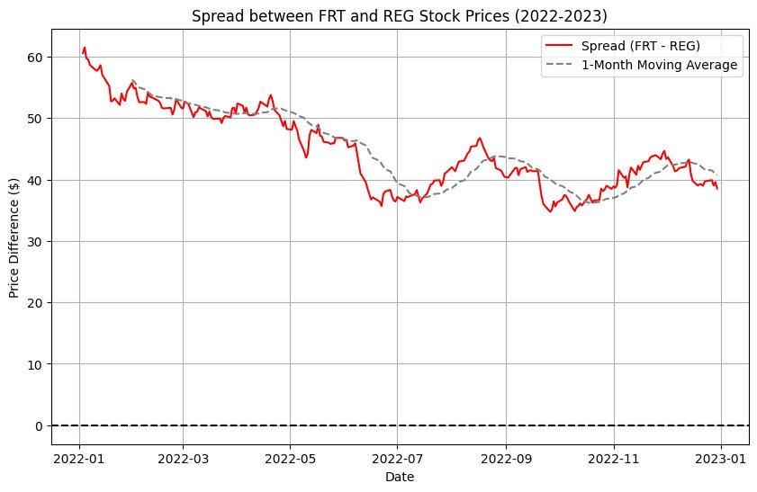
Mean Reversion and Predicting Deviations
Mean Reversion:
Asset prices tend to move back toward their historical average over time
The spread between two correlated assets will eventually revert to its long-term average
Spread Deviations:
Deviations from the historical spread between paired assets provide trading opportunities
Predictive models utilize historical data and statistical analysis techniques to anticipate potential deviations

Slide 8
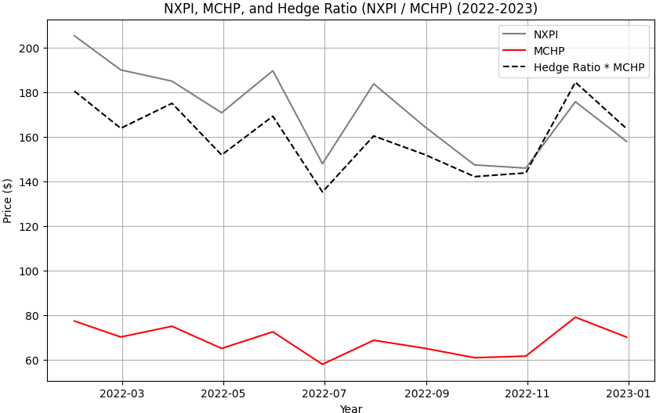
Understanding Dynamic Hedge Ratios
Hedge Ratio: How much of one stock to long/short relative to the other?
Dynamic hedge ratios adjust continuously based on changing market dynamics.
Optimize the portfolio's risk-return profile by dynamically rebalancing positions and finding the optimal ratio of long and short positions that would currently maximize profitability.

Slide 9
The Kalman Filter
The Kalman Filter is an advanced mathematical tool originally developed by rocket scientists and used in systems engineering.
Most Recent Data
Hedge Quantity
Predicted Standard Deviation
Forecast Error
It measures the spread of a pair by minimizing noisy data and provides a trading signal uninfluenced by unimportant market fluctuations.
This process iteratively updates and improves spread predictions at each time step.
Prediction
Update
Initial Estimates
Updated Parameters

Slide 10
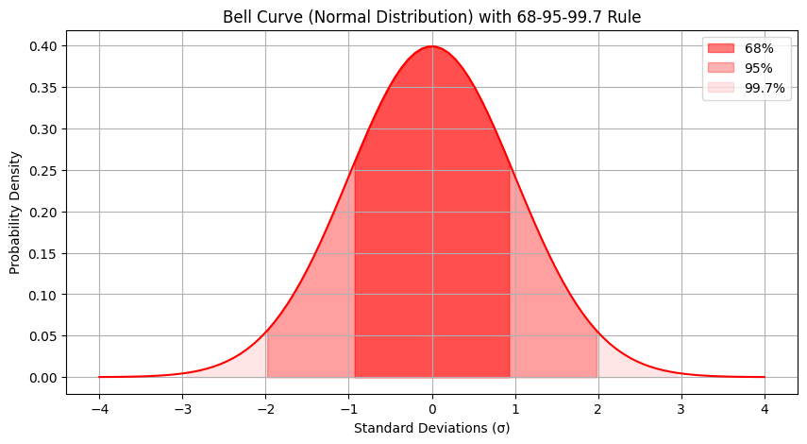
Pairs Selection Process: Our Prerequisites
Criteria Required for Kalman Filter
A stock's daily returns must follow a normal distribution.
What does this mean?
Test for Skewness: Between –0.5 and 0.5 (normal: 0)
Test for Kurtosis: Between 1.7 and 4.3 (normal: 3)
Notes:
Skewness and Kurtosis within these ranges to filter by risk exposure and manage risk exposure.

Slide 11
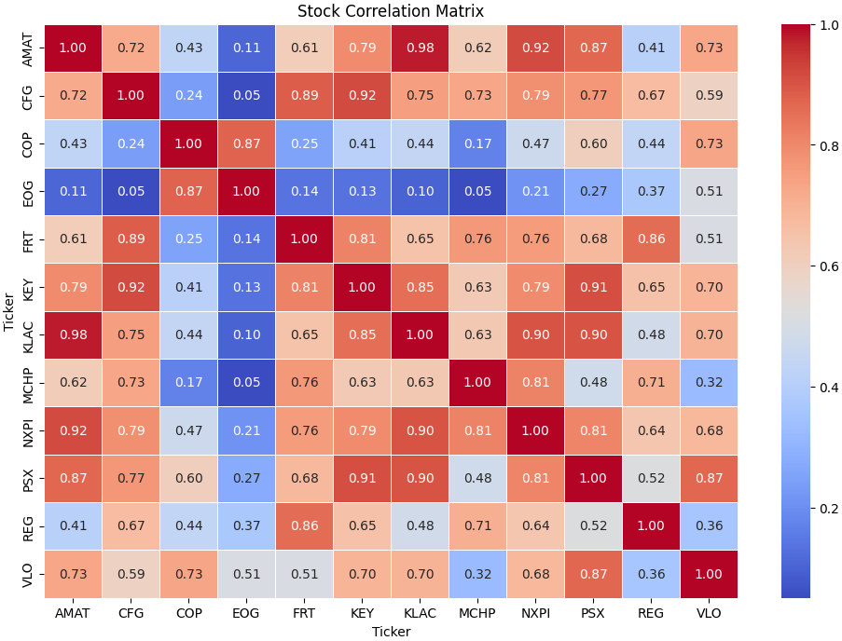
Pairs Selection Process: The Correlation Matrix

Slide 12
Pairs Selection Process: Cointegration Tests
Purpose: Find cointegrated asset pairs
Key Concept: Stable long-term relationship despite short-term price deviations.
Method: Statistical hypothesis testing for cointegration → confidence level
Engle-Granger Test
Augmented Dickey Fuller Test
Trading Application: Identifies pairs for strategies that capitalize on prices converging over time.

Slide 13
Pairs Selection Process: Ranking by Aggregate Volatility
NXPI - MCHP: 0.022131
KLAC - AMAT: 0.019921
KEY - CFG: 0.019349
VLO - PSX: 0.015638
FRT - REG: 0.012392
Volatility Ratings in Pairs Trading:
Low: val < 0.015
Moderate: 0.015< val <0.020
High: val > 0.020
Values reflects how much the prices of two correlated assets fluctuate.
Higher agg. volatility greater risk and potential profit;
Lower agg. volatility stability but lesser gains.

Slide 14
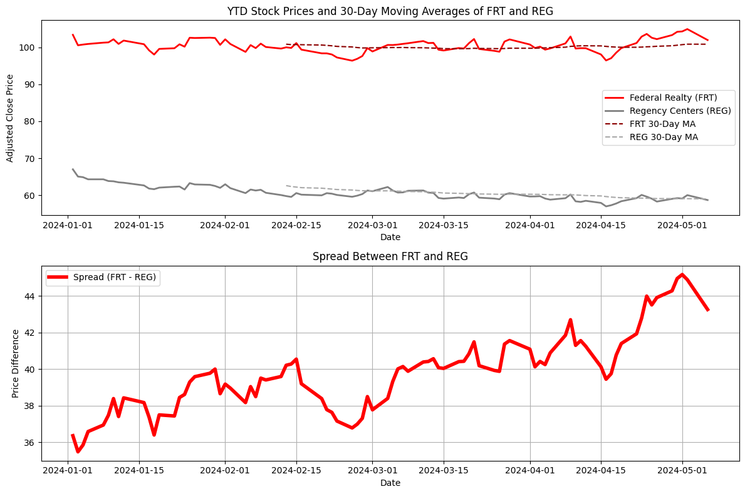


Introducing Our Pairs
Tickers: FRT – REG
Federal Realty Investment Trust (FRT)
Industry: Real Estate
Regency Centers Corporation (REG)
Industry: Real Estate

Slide 15
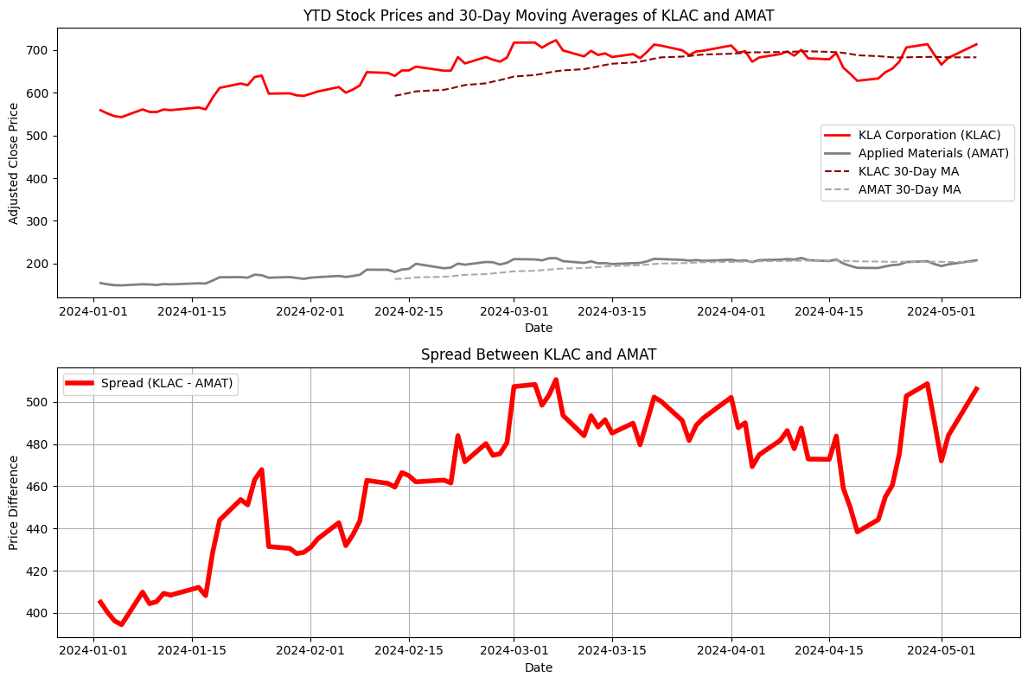


Introducing Our Pairs
Tickers: KLAC – AMAT
KLA Corporation (KLAC)
Industry: Semiconductor Equipment & Materials
Applied Materials, Inc. (AMAT)
Industry: Semiconductor Equipment & Materials

Slide 16
Algorithm Flowchart
Current Stock Prices
Update Kalman Filter
Forecast Error, Prediction Std Dev, Hedge Quantity
Currently invested in the pair?
NO: Is forecast error within range?
Place orders for long or short position
YES: What is the position?
Long:
Short:
Current Spread < Trailing Stop Loss: Liquidate
Current Spread > Trailing Stop Loss: Liquidate
For each pair:
Execute the function every 3-5 minutes of each trading day

Slide 17
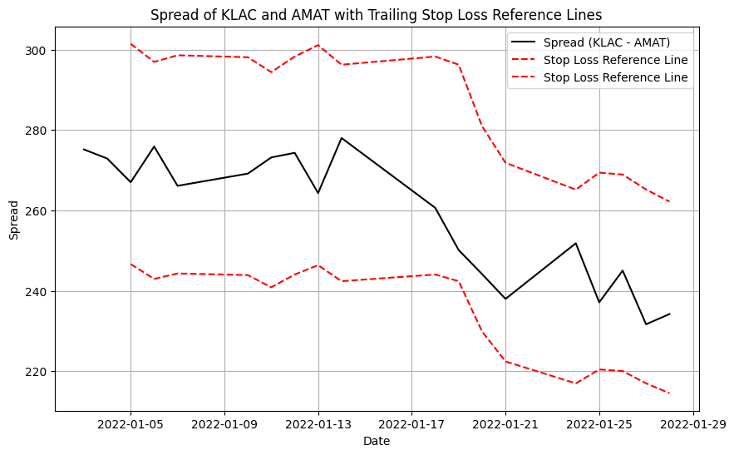
Risk Management: Trailing Stop Loss
Dynamic Protection: Automatically adjusts liquidation orders as prices move, protecting against potential losses.
Preserves Profits: It secures gains by selling if prices fall, ensuring capital preservation.
Notes:
Although our strategy is market neutral with a lot of risk management already integrated, we can still lose money when our predictions about the spread are wrong. In the event that our prediction about the spread is wrong, we have limit orders to liquidate our position and cut our losses at 10%. Our trailing stop loss goes one step further since our stop loss limit of 10% loss moves up with our position in order to preserve our profits, which is why it's trailing. On the right we have a graph of the moving average of the KLAC-AMAT spread along with the respective 10% stop losses relative to the moving average.

Slide 18
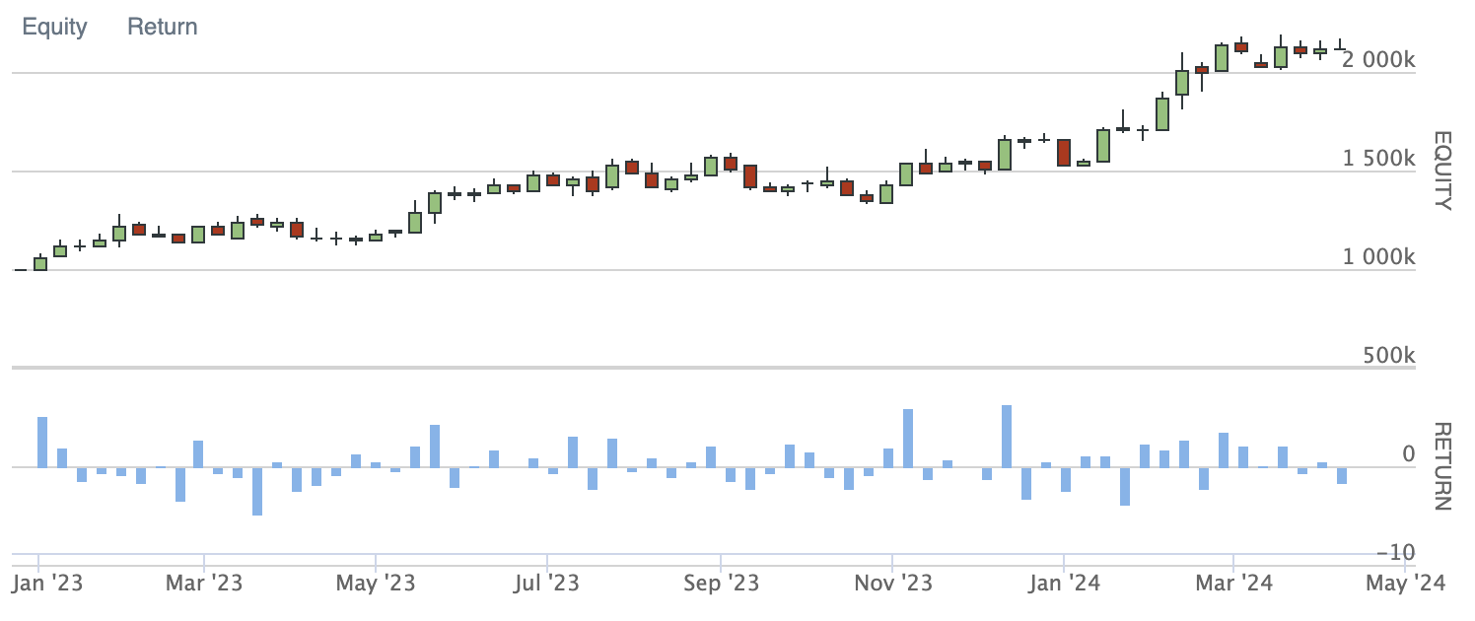
Back-Testing Results (2023 + YTD)
~70% trading in KLAC-AMAT,
30% trading in FRT-REG
Returns: 109.66%
Sharpe Ratio: 1.77
Compounding Annual Return: 77.6%
Alpha: 0.292
Max Drawdown: 15.3%
No trailing stop loss measure

Slide 19
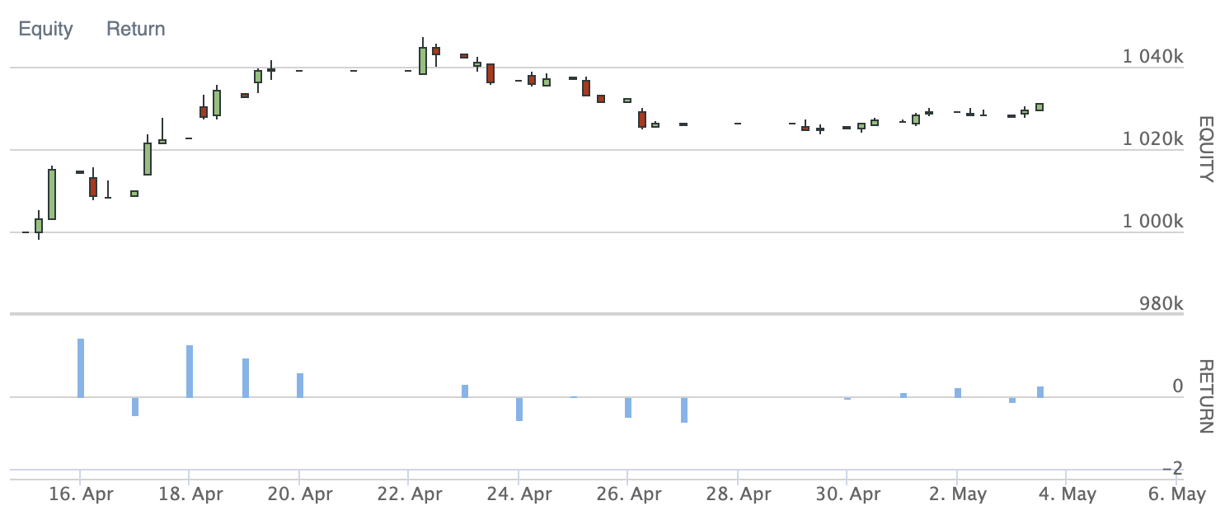
Live Trading Results
KLAC-AMAT Only
91% in trading at first, goes down to 58% by the end, rest is liquid reserves
Rolling 10% stop loss
3.11% returns over 2 weeks
Max Drawdown: 2.3%
Compounding Annual Returns: 82.123%
Alpha: 0.242
Sharpe Ratio: 2.585
SPY Returns over same period: 0.086%

Slide 20
Summary
Utilized a 4-step statistical analysis process to selectively filter and rank the best possible pairs to trade with out of the S&P 500
Leveraged the Kalman Filter to dynamically compute and update the hedge ratio between each pair
Cointegration can break down unexpectedly – qualitative analysis is critical
KLAC-AMAT is a pair that shows promising returns

Slide 21
Thank You
Questions?

